Slide 1
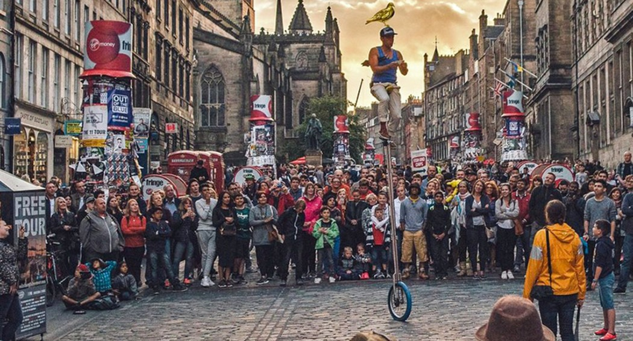


Edinburgh
Festival Fringe
All the world’s a stage
Group 19
Xiaoqi Shi, Xinyu Wang, Wenyu Liu, Weiran Li, Yueli Sun

Slide 2
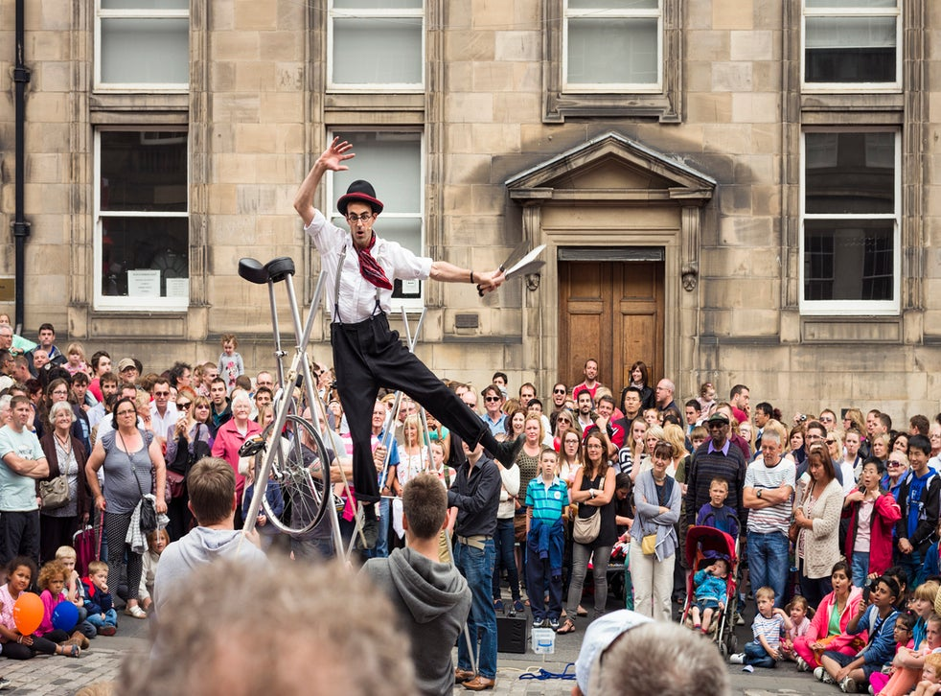

- CHALLENGE -
Introduction
The Fringe is an open access arts festival, which means that anyone who has a story to tell and a venue to perform in can put on a show here.
For three weeks in August the Edinburgh Festival Fringe opens the doors, streets and alleyways of an entire city to an explosion of creative energy from around the globe.
https://www.edfringe.com/learn/about#what-is-the-fringe

Slide 3



- CHALLENGE -
Motivation
Audience
The project aims to analyze the factors behind the success and marginalization of cultural workers at the Fringe.
Academics in Cultural and Creative Industries.
Fringe staff
The public and cultural workers, via media reports in newspapers, blog posts, etc
Data
We access the Edinburgh Festivals Listings API.
We focus on data from the Edinburgh Finge Festival between 2017 and 2019.
For each data set, each line represents a performance at Edinburgh Finge Festival in one year, while each column shows an aspect of a performance.
https://api.edinburghfestivalcity.com/documentation

Slide 4



- DATA ANALYSIS -
Data Format
Analysis Methods
In assignment 3, we analyze the data more deeply based on assignment 2. First of all, we further analyze the activities from different countries, activities that provide accessibility services, activities that provide different age groups, and the warnings provided by activities. We have focused on in-depth research on accessibility services and age stratification, combining these two factors with other meaningful information in the data. For example, we analyzed the types of activities providing accessibility services and the types of companies they were organized by.

Slide 5

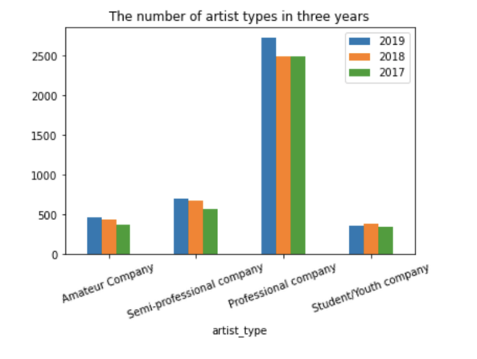
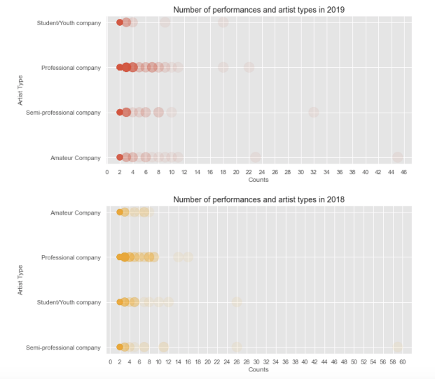
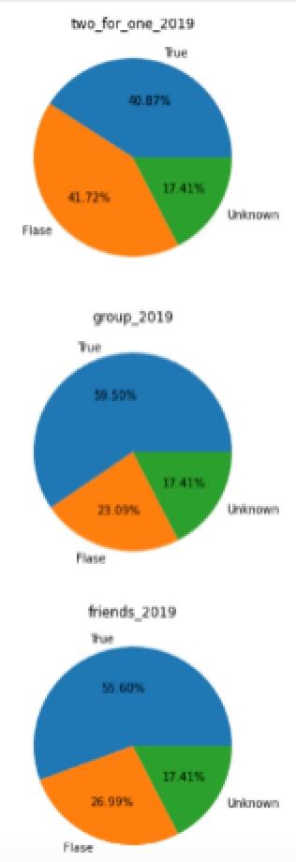
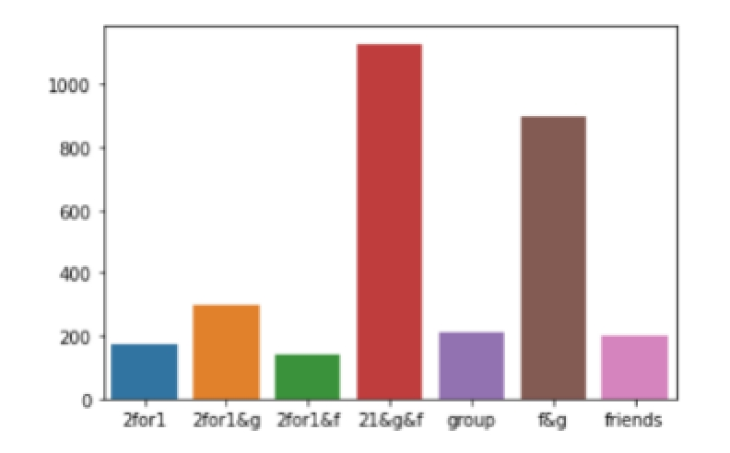
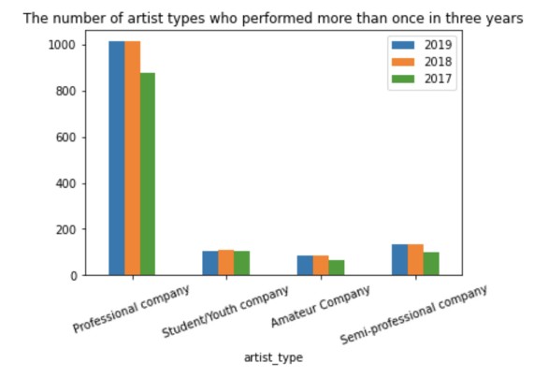
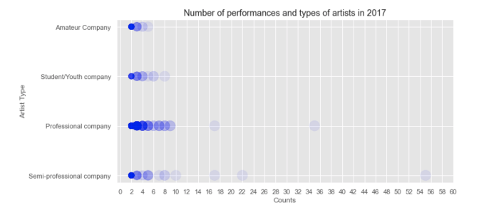
- DATA ANALYSIS -
Artist type
Number of performance & Artist type
Discounts
There are four types of companies holding these festivals. In the data of the past three years, professional company held a large proportion of activities. Apart from student / youth company, the festivals held by the other three companies are higher year by year. At the same time, most of the artists who performed many times also came from professional companies. In short, most of the artists who perform multiple programs at the festival come from professional companies.
According to the discount situation in 2019, it can be analyzed that the combination of discounts appears more frequently and more popular. Our group believes that the combination of discount also brings different groups of audience to participate in the festival.
According to the color of the dots: when the number of performances is 2, the artists may come from four types of companies. When the number of performances exceeds 3, more artists come from professional companies. The more professional artists we perform, the more likely we are to analyze them.

Slide 6
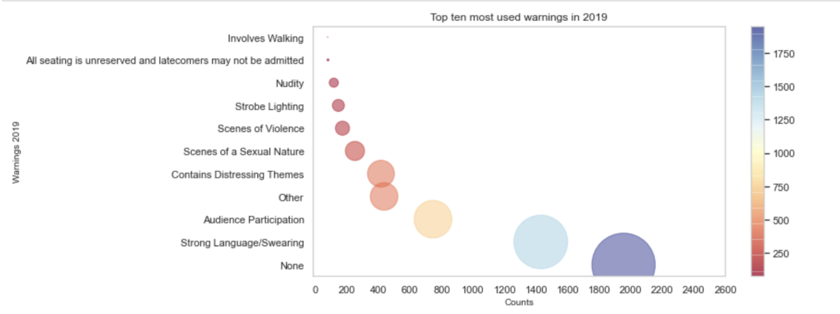
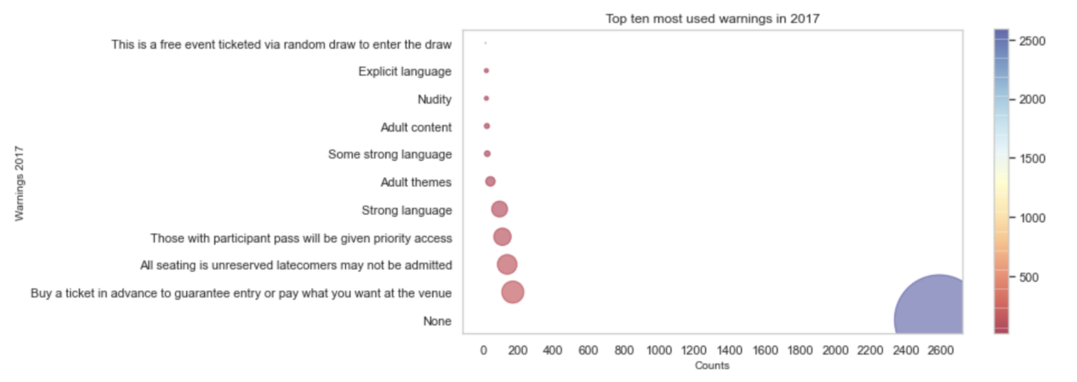
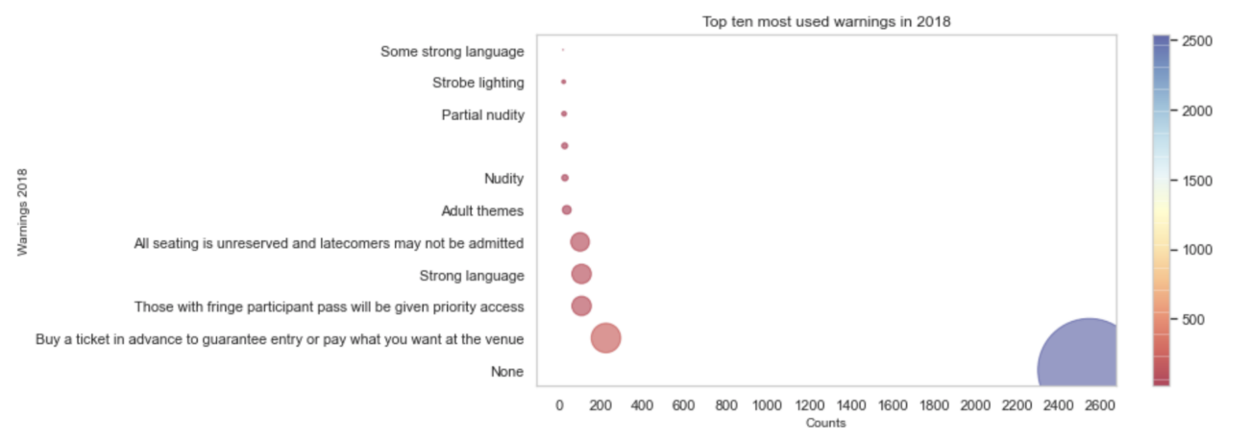
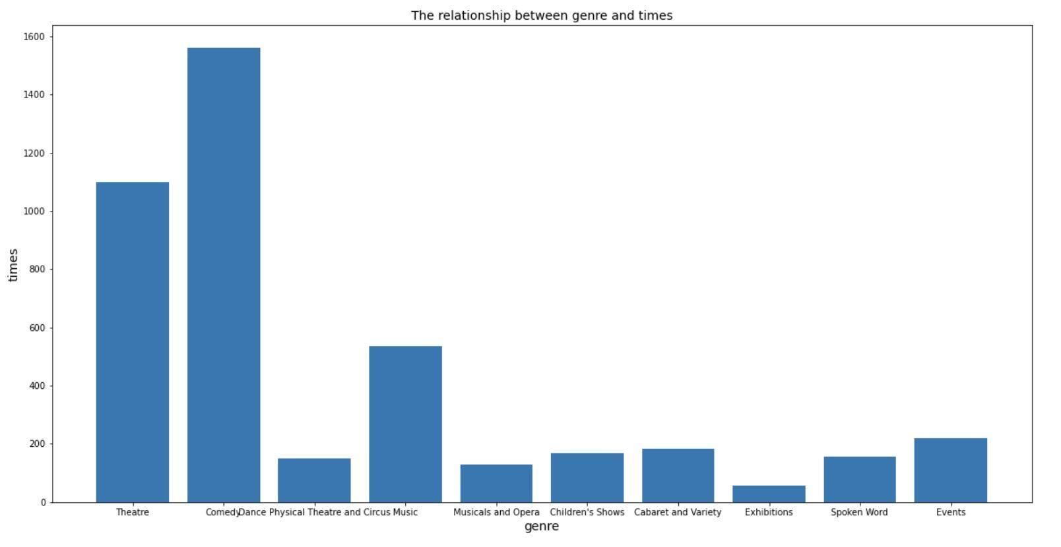
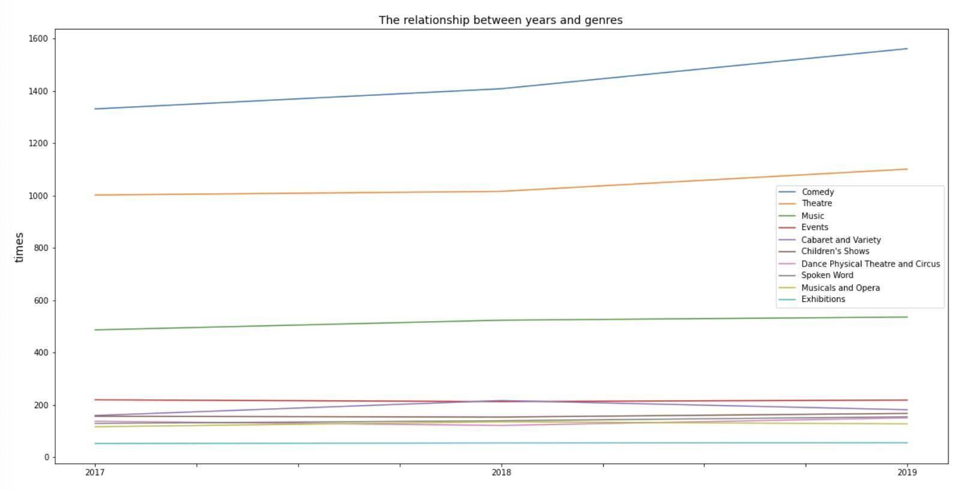
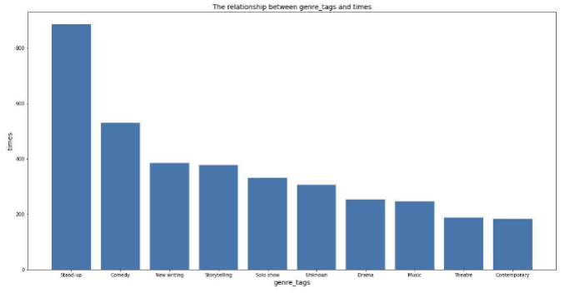
- DATA ANALYSIS -
Warnings
Statistics show that most programs do not have warnings. Most of the existing warnings in 2017-2018 are about ticket sales, admission and seating arrangements. However, in 2019, the type and number of such warnings have decreased. We believe that this may be related to the requirements of the local government or venue, and the organizers must strictly comply with the requirements set by the government and Venue Managers.
Genres
Number of performance & Genres
Tags
Then we analyze the trend of the number of festivals held in different types in three years. We find that the growth trend of "comedy" and "theatre" is more obvious, which is in line with the view that the two types are more popular. Then, we further analyze the data of genre.
This is the number of times various gene tags appear in the top ten. According to our analysis, this tag may be used for program promotion. The top ten tags are probably the most frequently used and easily searched tags by program organizers.
We have counted the times of various genres, and we can see that theatre and comedy are the two most popular festivals.

Slide 7

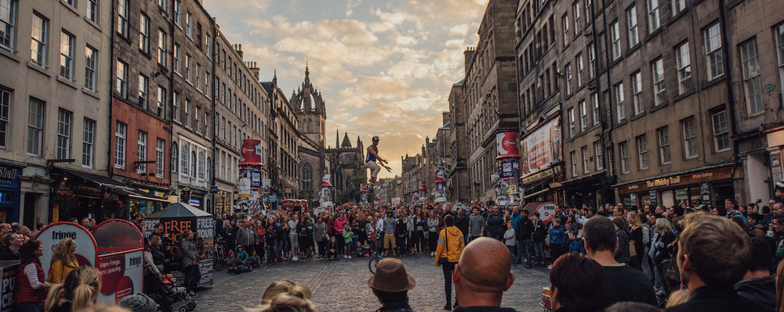
- DEMO LINK -
https://infogram.com/edinburgh-festival-fringe-1hmr6g7d3wx0z6n?live

Slide 8
- ANYTHING ELSE -
Missing work
Rationale for design choices
As the factors affecting the success of the activities are complex, we can not draw an objective and accurate conclusion about who is the most successful. For example, although we can use the available data to analyze that comedy is the most frequently held activity type, it may be due to its low cost. In addition, the size of the venue and the duration of the event are also factors affecting the judgment.
In the early stage, we are committed to obtaining an accurate conclusion about who is the most successful, and found relevant literature and mathematical methods to quantify success, but we lack some key data. Therefore, we decided to consider from the perspective of the target users, with the help of these data that can affect the success, analyse how can Fringe be more accessible for them.

Slide 9


Ask audience a question?

Slide 10
